Slide 1
BIOM 7110/8110
BIOSTATISTICS
Erno Lindner, Ph.D. (elindner@memphis.edu)
Amber Jennings, Ph.D. (jjnnings@memphis.edu)
M,W: 8:40-10:05
umdrive/elindner/public/biostatistics

Slide 2
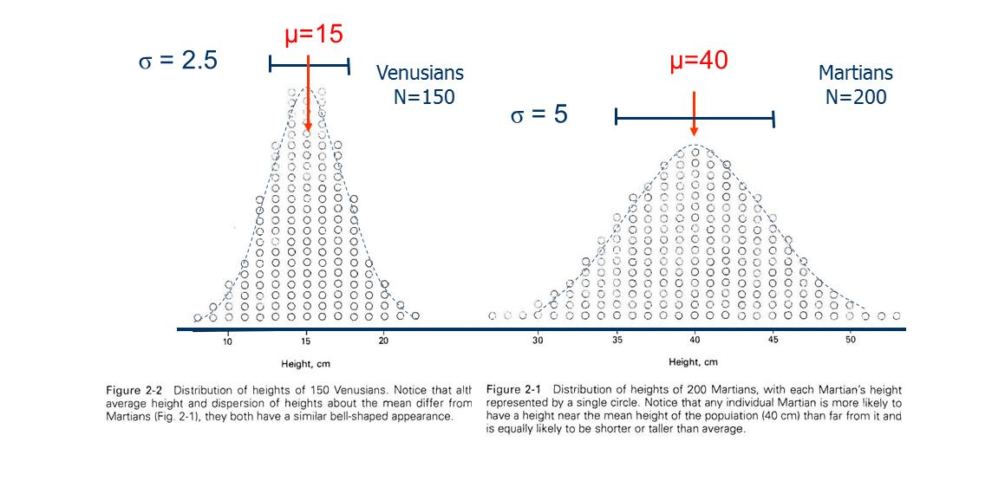

This pattern is very common when the observed measurement is the sum of many independent random factors
Normal distribution:
Height at a given X
$$f(x)=\frac{1}{σ\sqrt{2π}}exp\left[−\frac{1}{2}{\left(\frac{X−μ}{σ}\right)}^{2}\right]$$

Slide 3
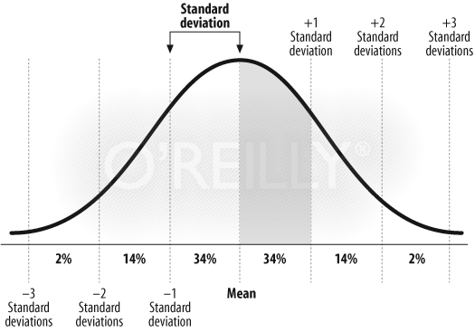
Areas Under the Normal Curve: Empirical rule
Empirical Rule for Data with Normal Distribution
68-95-99.7 rule
About 68% of all values fall within 1 standard deviation of the mean
About 95% of all values fall within 2 standard deviations of the mean
About 99.7% of all values fall within 3 standard deviations of the mean
Notes:
3

Slide 4


Normal distribution:
$$f(x)=\frac{1}{σ\sqrt{2π}}exp\left[−\frac{1}{2}{\left(\frac{X−μ}{σ}\right)}^{2}\right]$$
Standard Normal Distribution or z statistics
Sample
  $$z=\frac{x−\overline{x}}{s}$$
Population
  $$z=\frac{x−µ}{σ}$$
Z score
  Converts non-standard normal distribution to a standard normal distribution with mean of zero and standard deviation of one!

Slide 5
Using Excel
Function
  NORMSDIST(z)
  Returns the normal cumulative distribution of the normal standard curve (mean of zero, standard deviation of one) (Enter z, it returns probability)
Inverse functions in excel
NORMSINV
NORM.S.INV
  Returns the inverse of the cumulative normal standard distribution
  Enter probability, it returns z

Slide 6
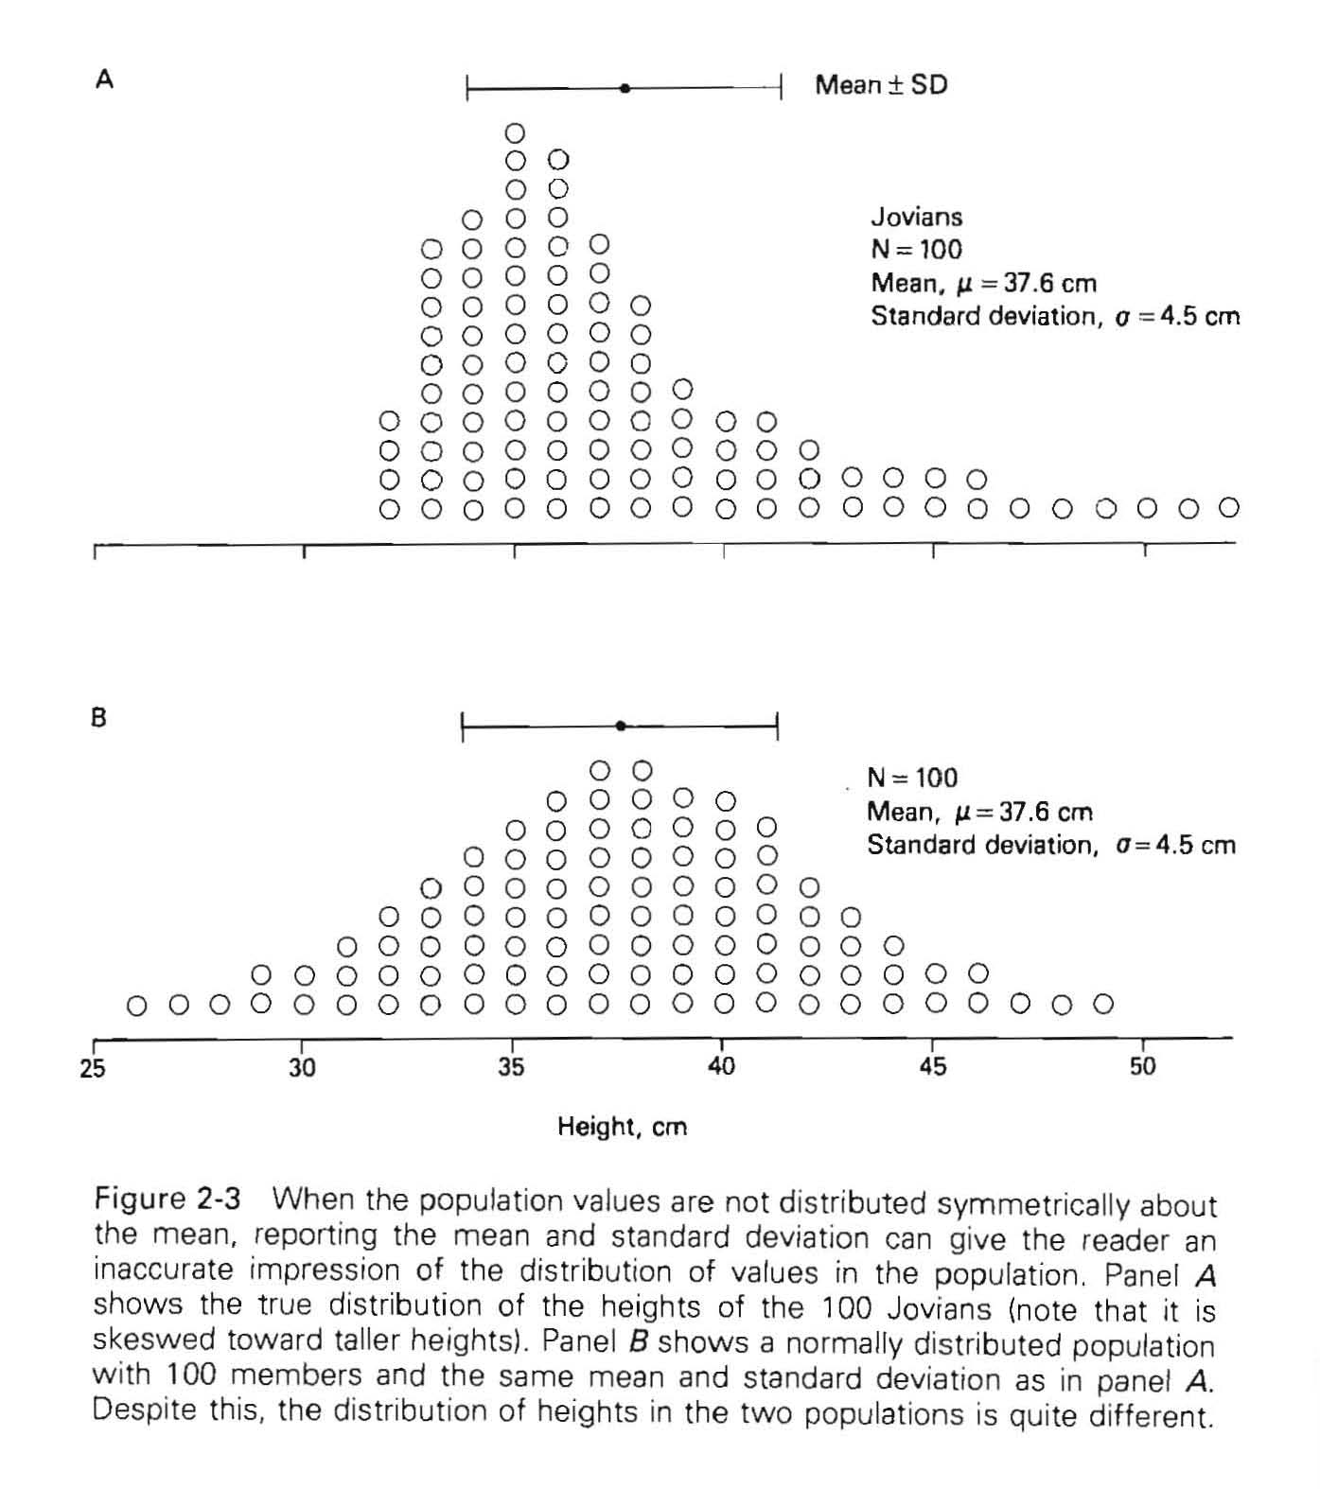
62 data
below the mean
25
75
 | Size | Mean | S.D.(p)
Martian | 200 | 40 | 5
Venusian | 150 | 15 | 2.5
Jovians | 100 | 37.6 | 4.5
50 data
below the mean
Normal distribution
In order to apply parametric statistical techniques the data should be normally distributed
There are a variety of techniques to assess whether the data are normally distributed – simplest is plotting the data

Slide 7
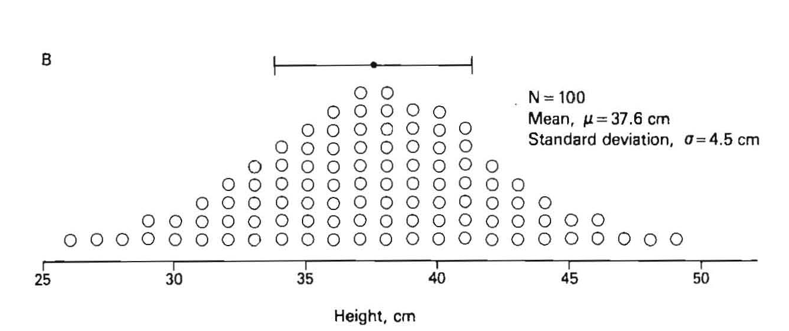
SKEWED DISTRIBUTION
Median=36
Mean: 37.6
Median=36
25% = 34
50% = 36
75% = 40
25
μ=37.6
75
34
40
NORMAL DISTRIBUTION
Mean= 37.6
Median=37.5
25% = 34
50% = 37.5
75% = 41
34
40
34
41

Slide 8
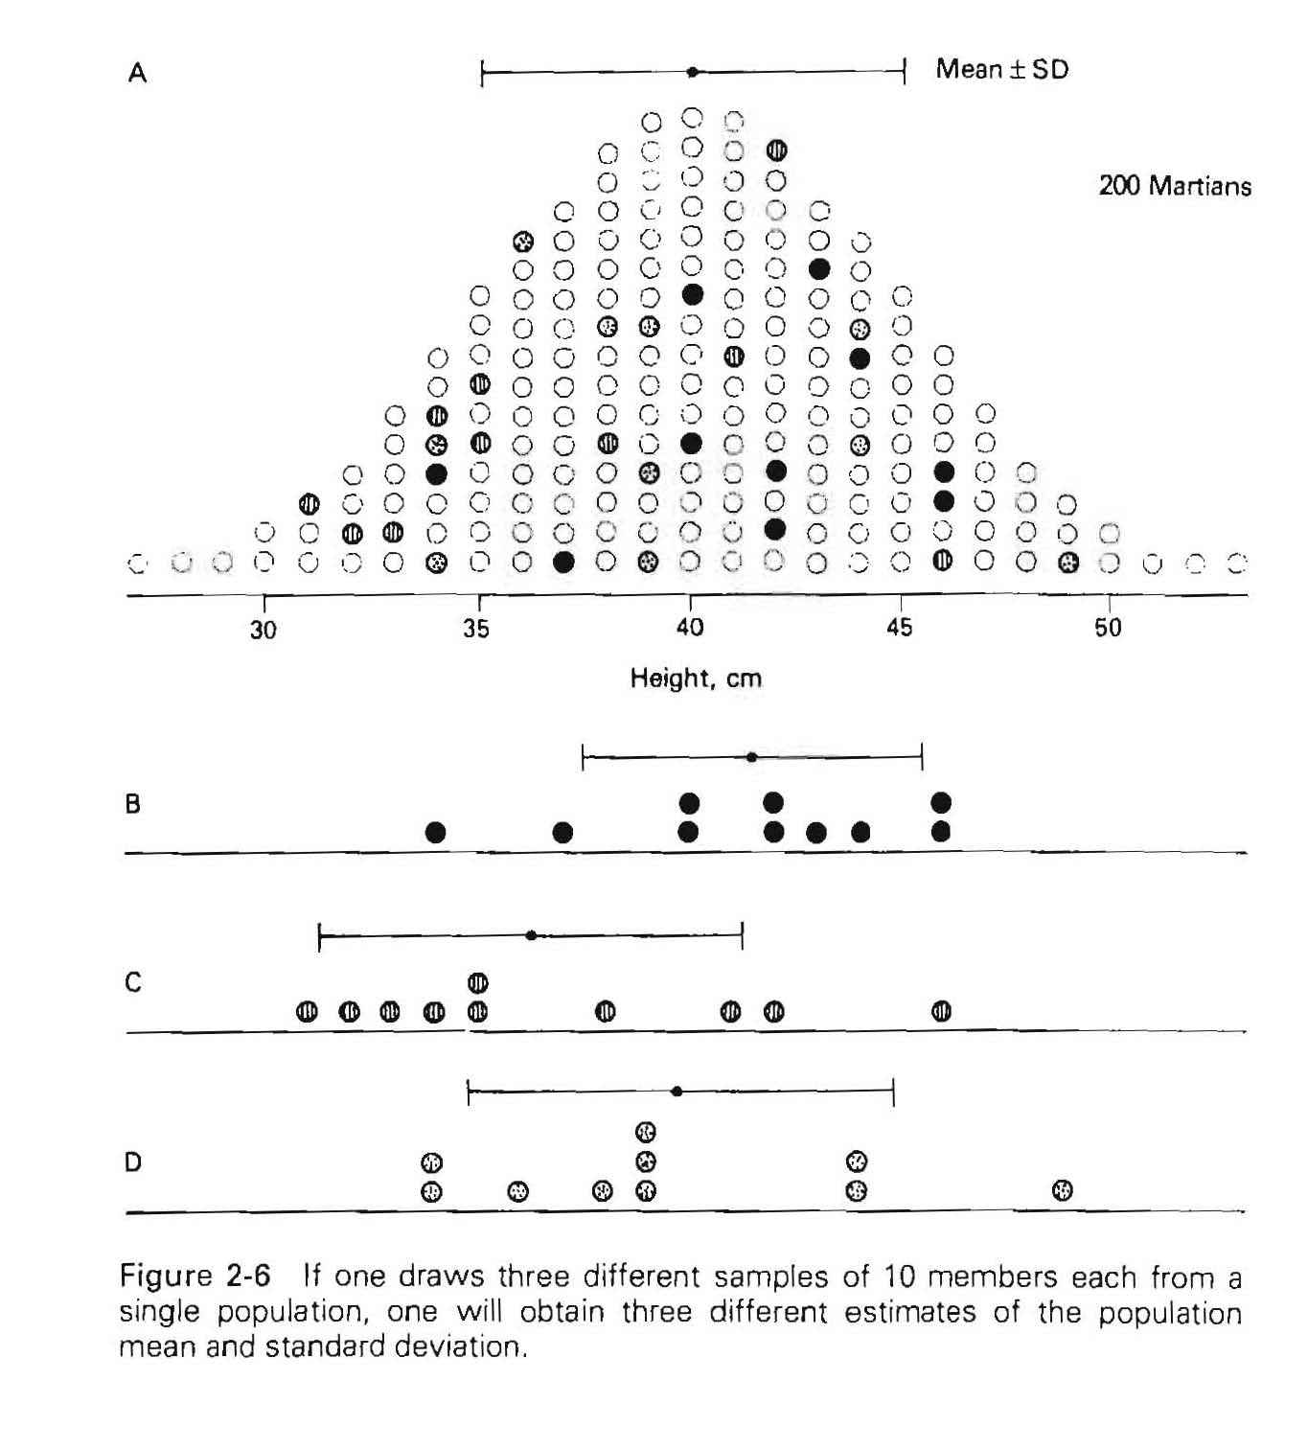
When we try to describe the properties of a population or attempt to provide information on the chemical composition of e.g., drinking water, air quality, etc., our conclusions are based on a limited number of observations or measurements.

Slide 9
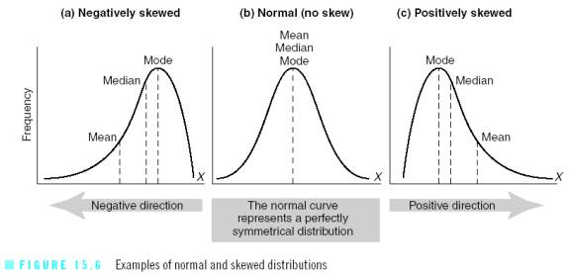
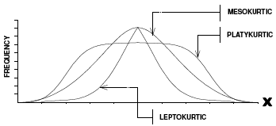
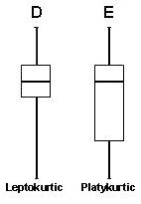

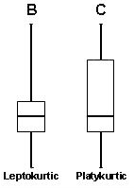
Shape distribution
Normal/bell shaped
  Symmetrical
Skewdness
  Positively or negatively skewed
Kurtosis
  Peaky vs flat
multimodal
(Normal)
Skewed left
Symmetrical
Skewed right

Slide 10
(normal)
Skewed left
Symmetrical
Skewed right

Slide 11
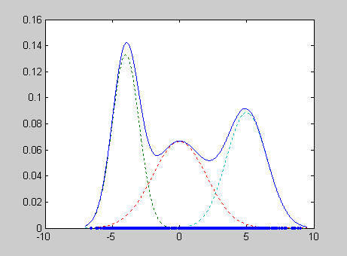
Shape distribution
Normal/bell shaped
  Symmetrical
Skewdness
  Positively or negatively skewed
Kurtosis
  Peaky vs flat
multimodal

Slide 12
Sampling distributions

Slide 13
Random sampling
If a sample of size n is drawn from a population of size N such that every possible sample of size n has the same probability of being selected, the sample is called a simple random sample

Slide 14

Properties of sampling distribution of mean
When sampling is from a normally distributed population, the sampling distribution of the mean will exhibit the following properties:
  The distribution of $\overline{x}$ will be normal
  The mean $μ_{\overline{x}}$ of the distribution of $\overline{x}$
    $μ_{\overline{x}}$₌µ
  The variance $σ_{\overline{x}}^{2}$, of the distribution of $\overline{x}$
    $σ_{\overline{x}}^{2}$= σ²/n

Slide 15
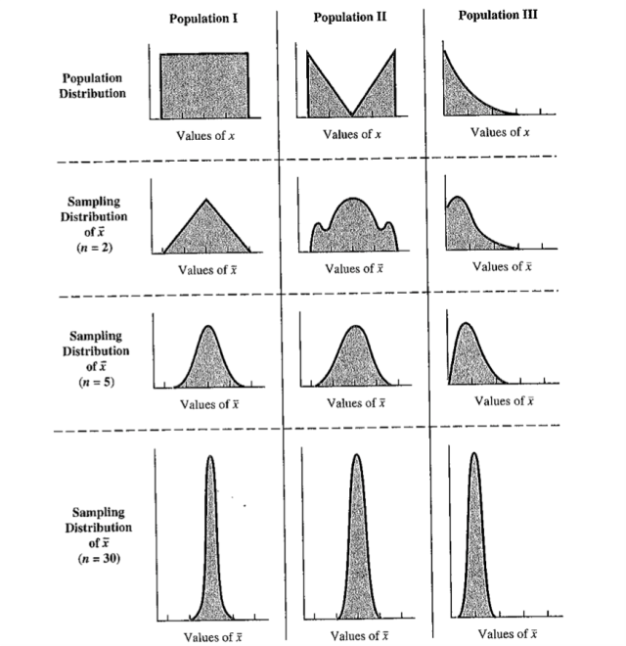

What about a non-normally distributed population
Central Limit Theorem
  Given a population of any non-normal functional form with mean µ and finite variance σ² , the sampling distribution of $\overline{x}$ computed from samples of size n from the population, will be approximately normally distributed with mean µ and variance σ²/n, provided n is large.
  Even if population is not Normal, sampling distribution may approximate normal if n is sufficiently large
  In general, if n≥30, you’re in good shape.
  Otherwise, you’re still okay as long as the population isn’t too non-normal
www.gondez.com

Slide 16
Rules of Thumb for CLT
If population distribution is Normal (as estimated by the distribution of individual data values in the sample):
Sampling distribution is always Normal

Slide 17
Rules of Thumb for CLT
If data distribution only modestly skewed:
  Longer whisker no more than 2 to 8X longer than shorter whisker
  No outliers
Sampling distribution is Normal if n ≥ 15
  n = 15 if whiskers 2X different
  n = 20 or 30 if whiskers 3 to 8X different

Slide 18
Rules of Thumb for CLT
If data distribution extremely skewed and (or) outliers present:
  Longer whisker 5 to 10X longer than shorter whisker
  Outliers present
Sampling distribution is Normal if n ≥ 40

Slide 19
Rules of Thumb for CLT
Are there any situations when n = 40 would not be sufficient to insure the sampling distribution is Normal?
  If outliers are > 100X different from the median of the data distribution
Sampling distribution is Normal only if n ≥ 100

Slide 20
Rules of thumb for CLT
CLT only applies to sampling distributions, not distribution of population
1 large sample n ≠ normal histogram

Slide 21
Why sampling distributions?
There is uncertainty in the sample statistics estimation of the true population mean.
Probability distributions provide basis for evaluating/interpreting uncertain evidence
Goal is to learn how to use sampling distributions to describe/infer something about a population(s)

Slide 22
In class /homework sampling
bmp-guinea pig
Survival of guinea pig
Excel
Random number between 0 and 171
=Roundbetween(2,172)
Lookup(P4,A$2:A$172,B$2:B$172
Index number
Data

Slide 23
Questions
Population mean: 76.5
Population st. dev: 10.3
means (n=5)
sample1 | sample2 | sample3 | sample4 | sample5 | sample6 | sample7 | sample8 | sample9 | sample10
70 | 82 | 70 | 64 | 83 | 78 | 73 | 66 | 84 | 72
means (n=20)
78 | 80 | 80 | 74 | 77 | 73 | 79 | 80 | 76 | 78
Why do multiple samples from same population have different values?
Ans: Random Sampling Variation
  Assumptions: unbiased, large sample and independent observations

Slide 24
Questions
What does ‘unbiased’ mean?
Ans: Values of the sample statistic computed from repeated samples from the same population are equally likely to fall above or below the true parameter value.
If we make histogram chart of n=5 and n=20 values – are values normally distributed?

Slide 25
Questions
If an unbiased sampling study is repeated many times, and a histogram of the sample statistics is constructed, where would the true parameter value fall in the histogram?
Ans: In the center (statistic values equally above and below).

Slide 26
Distribution of the mean heart rate values in a sampling experiment with n=5 and n=20 sample size

Slide 27
Questions
How does ave of n=5 samples and ave of n=20 samples compare?
Ans: The larger the sample size used to compute a sample statistic, the more precise will be the statistic. What does “precise” mean ?
  Ans: Values of the sample statistic computed from repeated samples from the same population will be very similar (little random variation).

Slide 28
Questions
What is the effect of increasing sample size n ?
  Ans: The impact of unusual individuals in the sample is diluted in large samples.
  Ans: The histogram for large samples would have a smaller spread (less random variation).

Slide 29
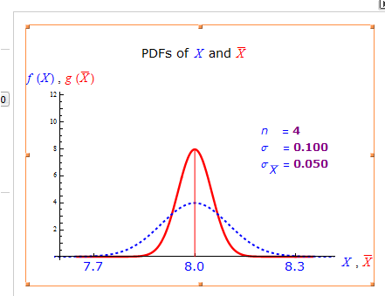
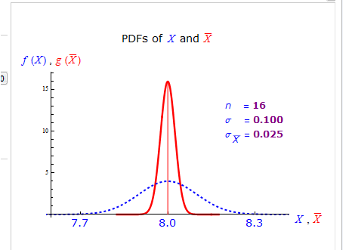
So
If an unbiased sampling study is repeated many times, and a histogram of the various values of the sample statistic were constructed, the histogram for repeated large samples will exhibit less random variation than a histogram for repeated small samples

Slide 30
Question
Random samples with large sample size can be expected to provide “accurate” estimates of the true parameter value. What does “accurate” mean ?
Ans: Values of the sample statistic computed from repeated samples from the same population will be very close to the true parameter value.

Slide 31
Question
Does this mean that a statistic computed from a large random sample cannot be quite different from the true parameter value?
Ans: NO, but this outcome is very unlikely to occur (very low probability).
This forms the basis of ‘hypothesis’ testing

Slide 32


Sampling Distribution of $\overline{x}$-bar
Center: E ( $\overline{x}$ ) = μ
Spread: $σ_{\overline{x}}=\frac{σ}{\sqrt{n}}$
Shape: Normal in the following situations:
  If the population distribution is Normal
  If the sample size is sufficiently large that the Central Limit Theorem “rules of thumb” apply.

Slide 33
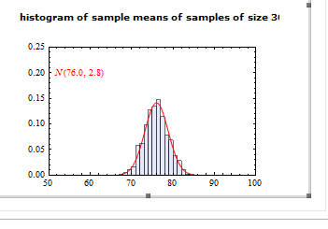
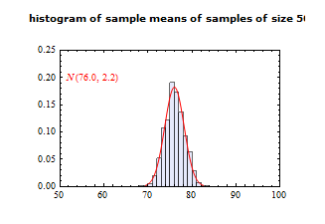
Extra visualizations
Wolfram demonstrations project
http://demonstrations.wolfram.com/SamplingDistributionOfTheSampleMean/
http://demonstrations.wolfram.com/SamplingDistributionOfTheMeanAndStandardDeviationInVariousPo/

Slide 34
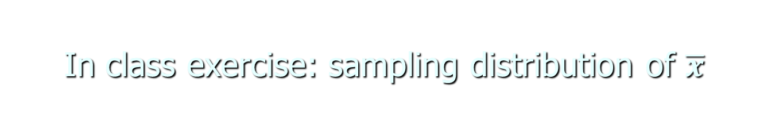
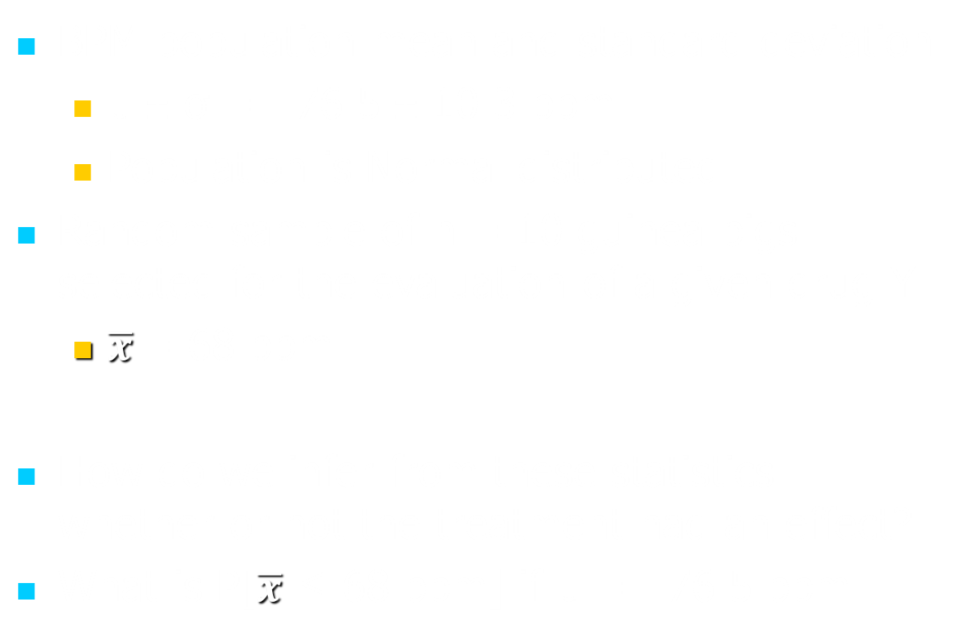
In class exercise: sampling distribution of $\overline{x}$
BPM population mean and standard deviation
  µ ± σ = 76.5 ± 10.3 bpm
  Population is Normal distributed
Random sample of n = 10 guinea pigs selected for the evaluation of a given drug Y
  $\overline{x}$= 68 bpm
How do we infer from these statistics whether or not the treatment had an effect?
What is P[$\overline{x}$ ≤ 68 bpm] if µ = 76.5 bpm

Slide 35

In class exercise: sampling distribution of $\overline{x}$
Is sampling distribution Normal?
  ANS: yes b/c population is normal
The center or expected value E(x) =
Spread of sampling distribution σ_{x̄} = 10.3/(10^0.5)_ =
P[ x ≤ 68 bpm] = P[ Z ≤ (68-76.5)/3.26 ]
= P[ Z ≤ -2.61 ]
=0.0045
76.5
3.26

Slide 36


In class exercise: sampling distribution of $\overline{x}$
Guinea Pig population survival mean and std dev
  µ ± σ = 159 ± 129 survival days
  Population is NOT normally distributed
Check CLT
  Data are moderately skewed, with some outliers, n >40
Random sample of n = 45 guinea pigs selected for evaluation
  $\overline{x}$ = 101 survival days
What is P[$\overline{x}$ ≤ 101 days] if µ =159 days

Slide 37

In class exercise: sampling distribution of $\overline{x}$
¯
Is sampling distribution Normal?
  ANS: yes b/c sample size n > 40 from non normal population with extreme skewdness and outliers (not extreme outliers) is normal
The center or expected value E(x) = 159
Spread of sampling distribution σ_{x̄} = $\frac{129}{\sqrt{45}}=19.2$
P[ x̄ ≤ 101 days] = P[ Z ≤ $\frac{101−159}{19.2}=−3.02$
= P[ Z < -3.02 ] = 0.0013

Slide 38
Importance
In both examples with bpm and guinea pig survival, the probability of selecting the given samples from the parent population is quite small (probabilities were < 1%) – this then implies that any treatment we gave these subjects had an effect – i.e. changed the subjects so that the sample is no longer representative of the parent (expected) population value
  Reject null hypotheses
  Sufficient evidence to warrant the claim that Drug Y has an effect on bpm and survival days

Slide 39
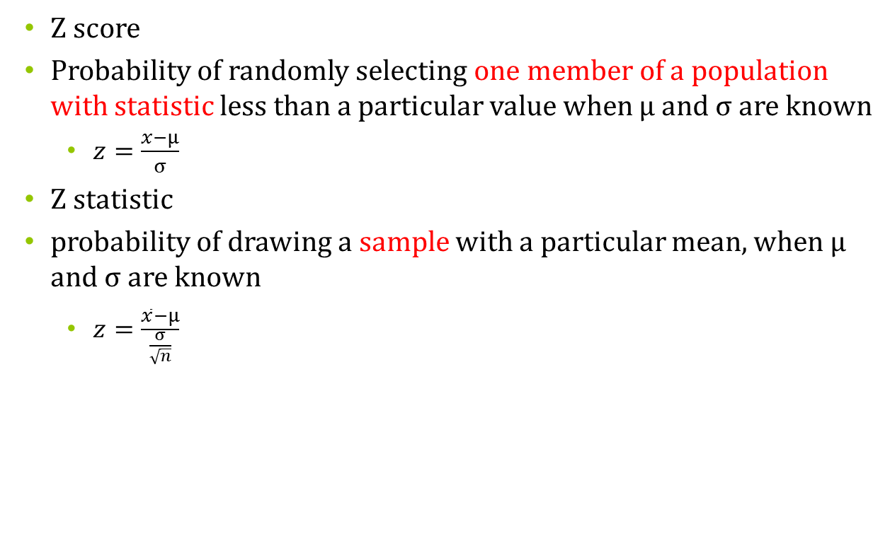
Difference between z score and z statistic
  Z score
  Probability of randomly selecting one member of a population with statistic less than a particular value when µ and σ are known
    $z=\frac{x−µ}{σ}$
  Z statistic
  probability of drawing a sample with a particular mean, when µ and σ are known
    $z=\frac{\overline{x}−µ}{\frac{σ}{\sqrt{n}}}$

Slide 40

Distribution of the difference between two sample means
Frequently the interest of investigation is focused on two populations
  E.g. one group taking a new anti-platelet drug and the other a placebo.
  Question: Are the population means of some parameter (platelet count) different between the population on the drug and not on the drug.
The relevant statistic is the difference between the two sample means
x̄₁-x̄₂
  $$z=\frac{\left(\overline{x1}−\overline{x2}\right)−(µ1−µ2)}{\sqrt{\frac{{σ_{1}}_{}^{2}}{n1}+\frac{{σ_{2}}_{}^{2}}{n2}}}$$

Slide 41
Distribution of the difference between two sample means
If both are normally distributed with means µ₁ and µ₂ and variances σ₁² and σ₂² , respectively the sampling distribution of the difference x̄₁₋x̄_{2,} between means of independent samples of size n₁ and n₂ drawn from these populations is normally distributed with mean µ₁-µ₂ and variance (σ₁²/n₁)+ (σ₂²/n₂)

Slide 42

Example
To investigate the effects of a new anti-platelet drug two samples are drawn from the patient population an n of 15 was placed on the drug and an n of 10 was placed on placebo. The difference between the two sample means x̄₁₋x̄₂ is 50 platelets /ul
σ₁²=19,600; n=15
σ₂²=8,100; n=10
  Null hypothesis: µ₁-µ₂=0
  Test statistic
  $z=\frac{\left(\overline{x1}−\overline{x2}\right)−(µ1−µ2)}{\sqrt{\frac{{σ_{1}}_{}^{2}}{n1}+\frac{{σ_{2}}_{}^{2}}{n2}}}$=

Slide 43
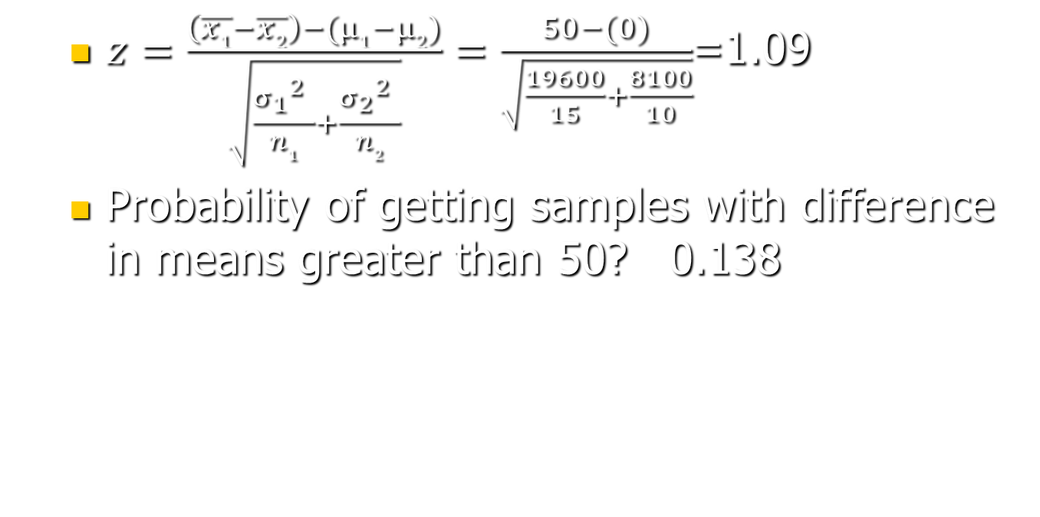
Example
  $z=\frac{\left(\overline{x1}−\overline{x2}\right)−(µ1−µ2)}{\sqrt{\frac{{σ_{1}}_{}^{2}}{n1}+\frac{{σ_{2}}_{}^{2}}{n2}}}=\frac{50−(0)}{\sqrt{\frac{19600}{15}+\frac{8100}{10}}}$=1.09
  Probability of getting samples with difference in means greater than 50? 0.138

Slide 44


What not to do

